Slide 1
PROJECT-34
GROUP-03

Slide 2
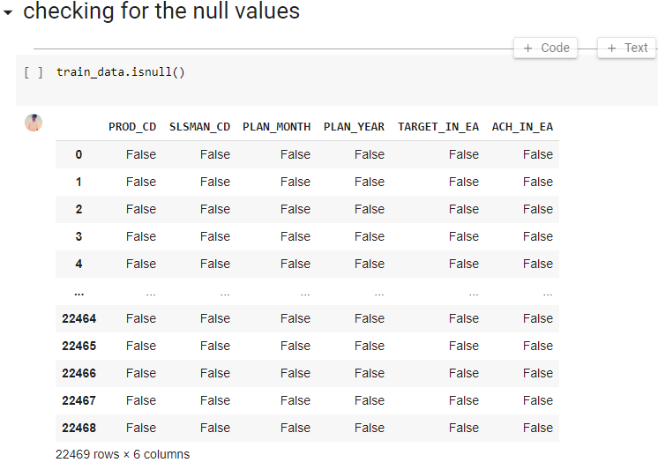
CHECKING NULL VALUES

Slide 3
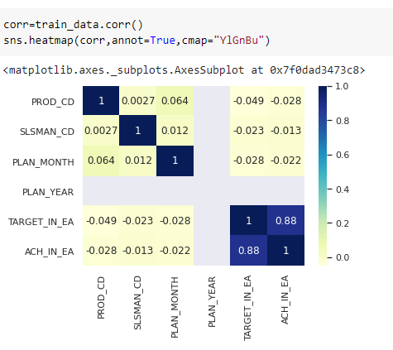
CO-RELATION OF DATA

Slide 4
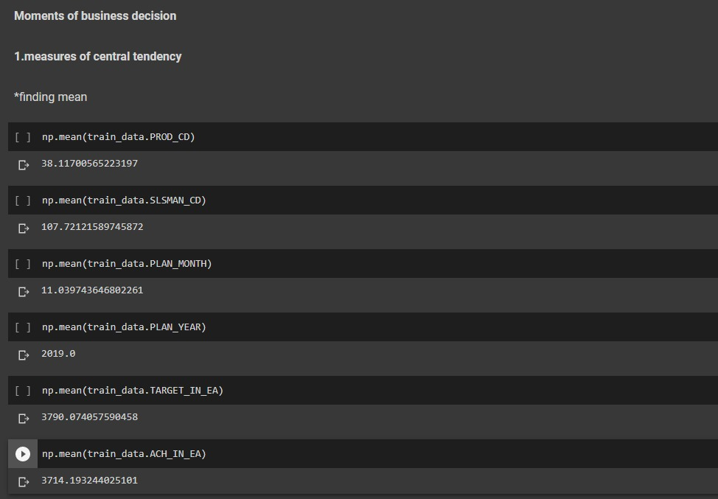
Business movement decision using central tendency

Slide 5
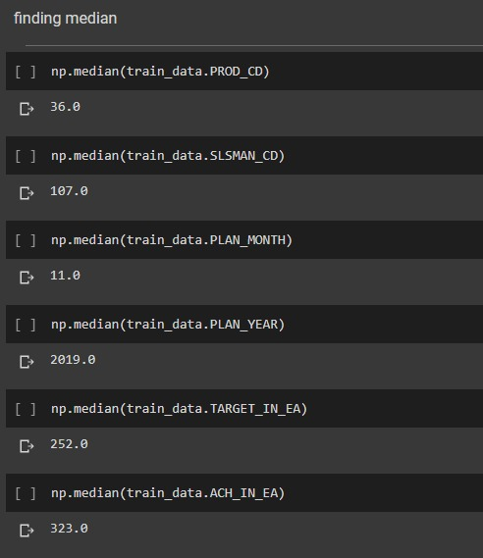
Business movement decision using medium

Slide 6
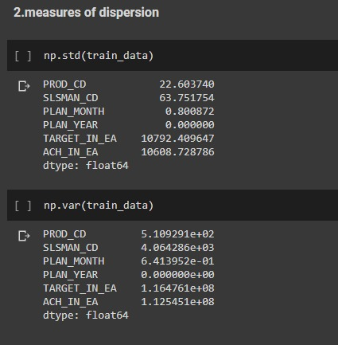
Business movement decision using dispersion

Slide 7
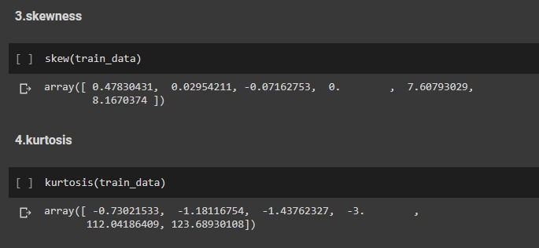
Business movement decision using skewness and kurtosis

Slide 8
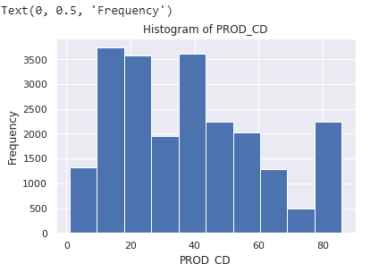
HISTOGRAM OF PRODUCT CODE

Slide 9
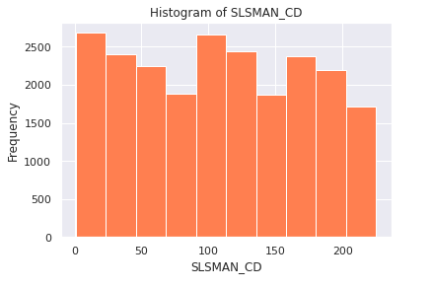
HISTOGRAM OF SALESMAN CODE

Slide 10
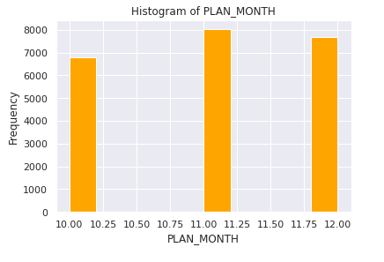
HISTOGRAM OF MONTH

Slide 11
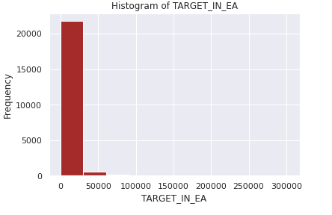
HOSTOGRAM OF TARGET

Slide 12
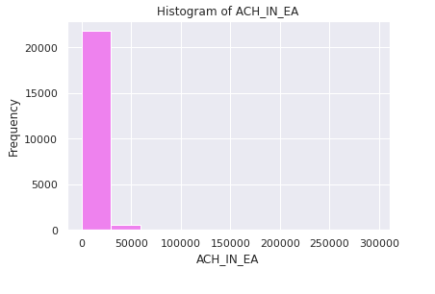
HISTOGRAM OF TARGET ACHIEVE

Slide 13
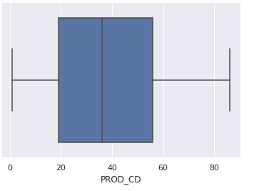
BOX PLOT USING PRODUCT CODE

Slide 14
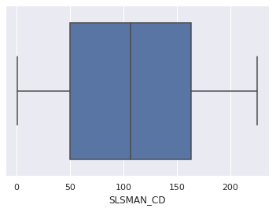
BOX PLOT USING SALESMAN CODE

Slide 15
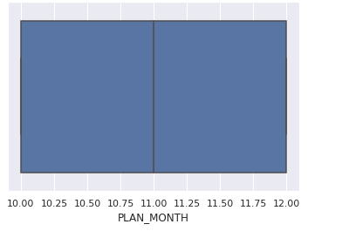
BOX PLOT USING AVERAGE MONTH PLAN

Slide 16
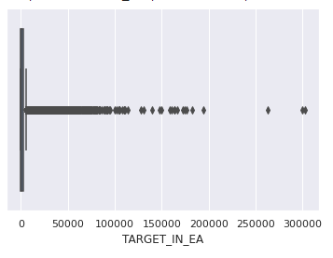
BOX PLOT USING TARGET

Slide 17
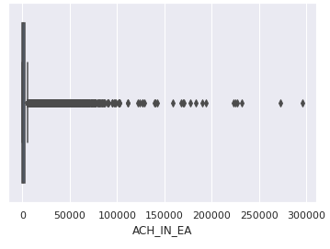
BOX PLOT USING TARGET ACHIVED

Slide 18
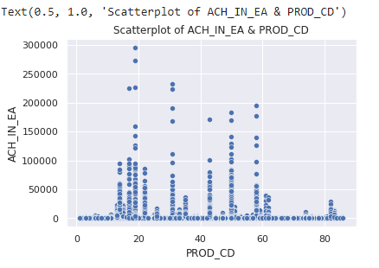
SCATTERED PLOT OF PRODUCT CODE

Slide 19
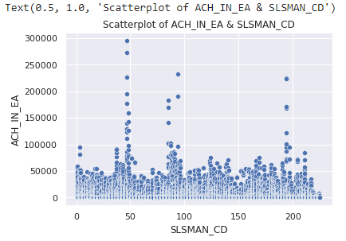
SCATTERED PLOT OF SALESMAN CODE

Slide 20
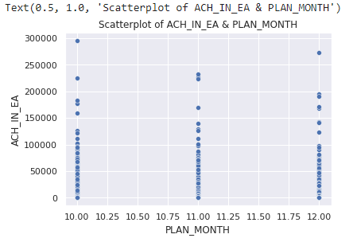
SCATTERED PLOT USING TARGET ACHIEVED

Slide 21
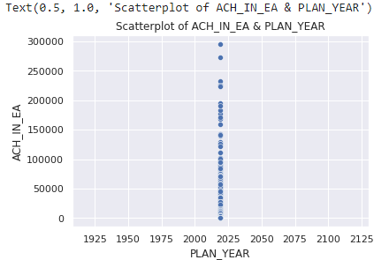
SCATTERED PLOT OF TARGET ACHIEVED IN YEAR

Slide 22
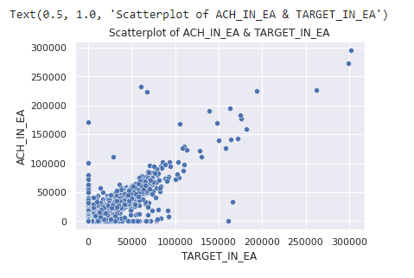
SCATTERED PLOT OF TARGET

Slide 23
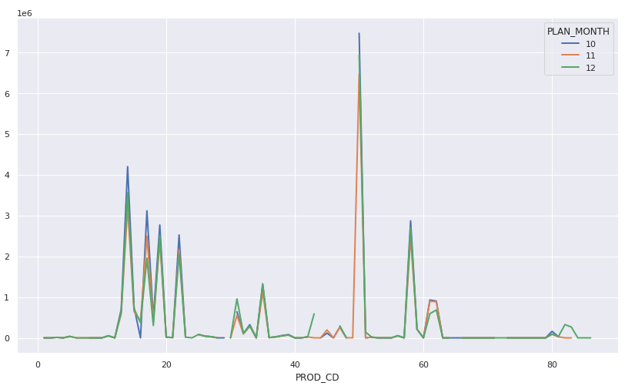
Stack overflow of product code

Slide 24
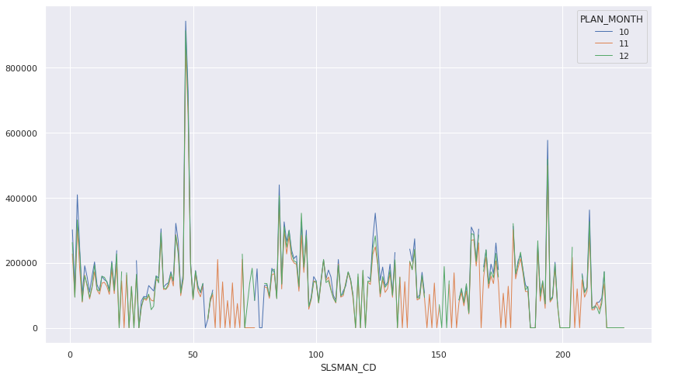
Stack overflow of salesman code

Slide 25
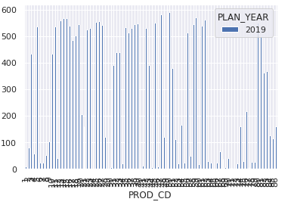
Manipulation of product code

Slide 26
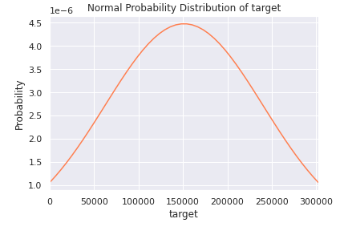
Probability of target

Slide 27
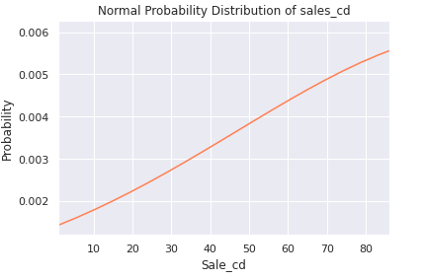
Probability of sales

Slide 28
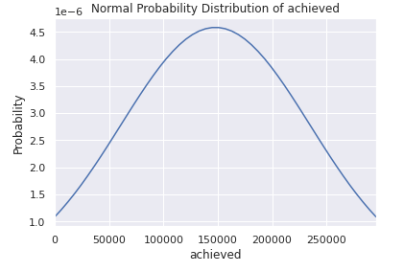
Probability of sales achived

Slide 29
THANK YOU
BY,
Sainath dahibhate
Prajwal dhumal
chandhan n
sarfaraz Ansari
Harish soni
mohammed umar farooq

